Slide 1
Microelectronics and VLSI IT705D __________________________ Module 3: Microelectronics Process for VLSI Fabrication

Slide 2
Module3: Microelectronics Process for VLSI Fabrication
VLSI Fabrication
Silicon Semiconductor Technology
Wafer processing, Oxidation, Epitaxial deposition, Ion implantation & Diffusion, Cleaning, Etching, Photolithography (Positive & Negative Photoresist)
Basic CMOS Technology
Steps in fabricating CMOS, n-well and p-well process, twin tub process, silicon on insulator
Layout Design Rules
Stick diagram with example, Layout rules

Slide 3
Fabrication
Masks
Chips
Processed Wafer
Processing
Wafers

Slide 4
Fabrication process sequence
1.Silicon manufacture
2.Wafer processing
3.Lithography
4.Oxide growth and removal
5.Diffusion and ion implantation
6.Annealing
7.Silicon deposition
8.Metallization
9.Testing
10.Assembly and packaging

Slide 5
1. Silicon manufacture
Pure silicon is melted in a pot (1400º C) and a small seed containing the desired crystal orientation is inserted into molten silicon and slowly(1mm/minute) pull out.
2. Wafer processing
The silicon crystal (in some cases also containing doping) is manufactured as a cylinder (ingot) with a diameter of 6 -12 inches. (1"=2.54cm)
This cylinder is carefully sawed into thin(0.50-0.75 mm thick) disks called wafers, which are later polished and marked for crystal orientation.

Slide 6
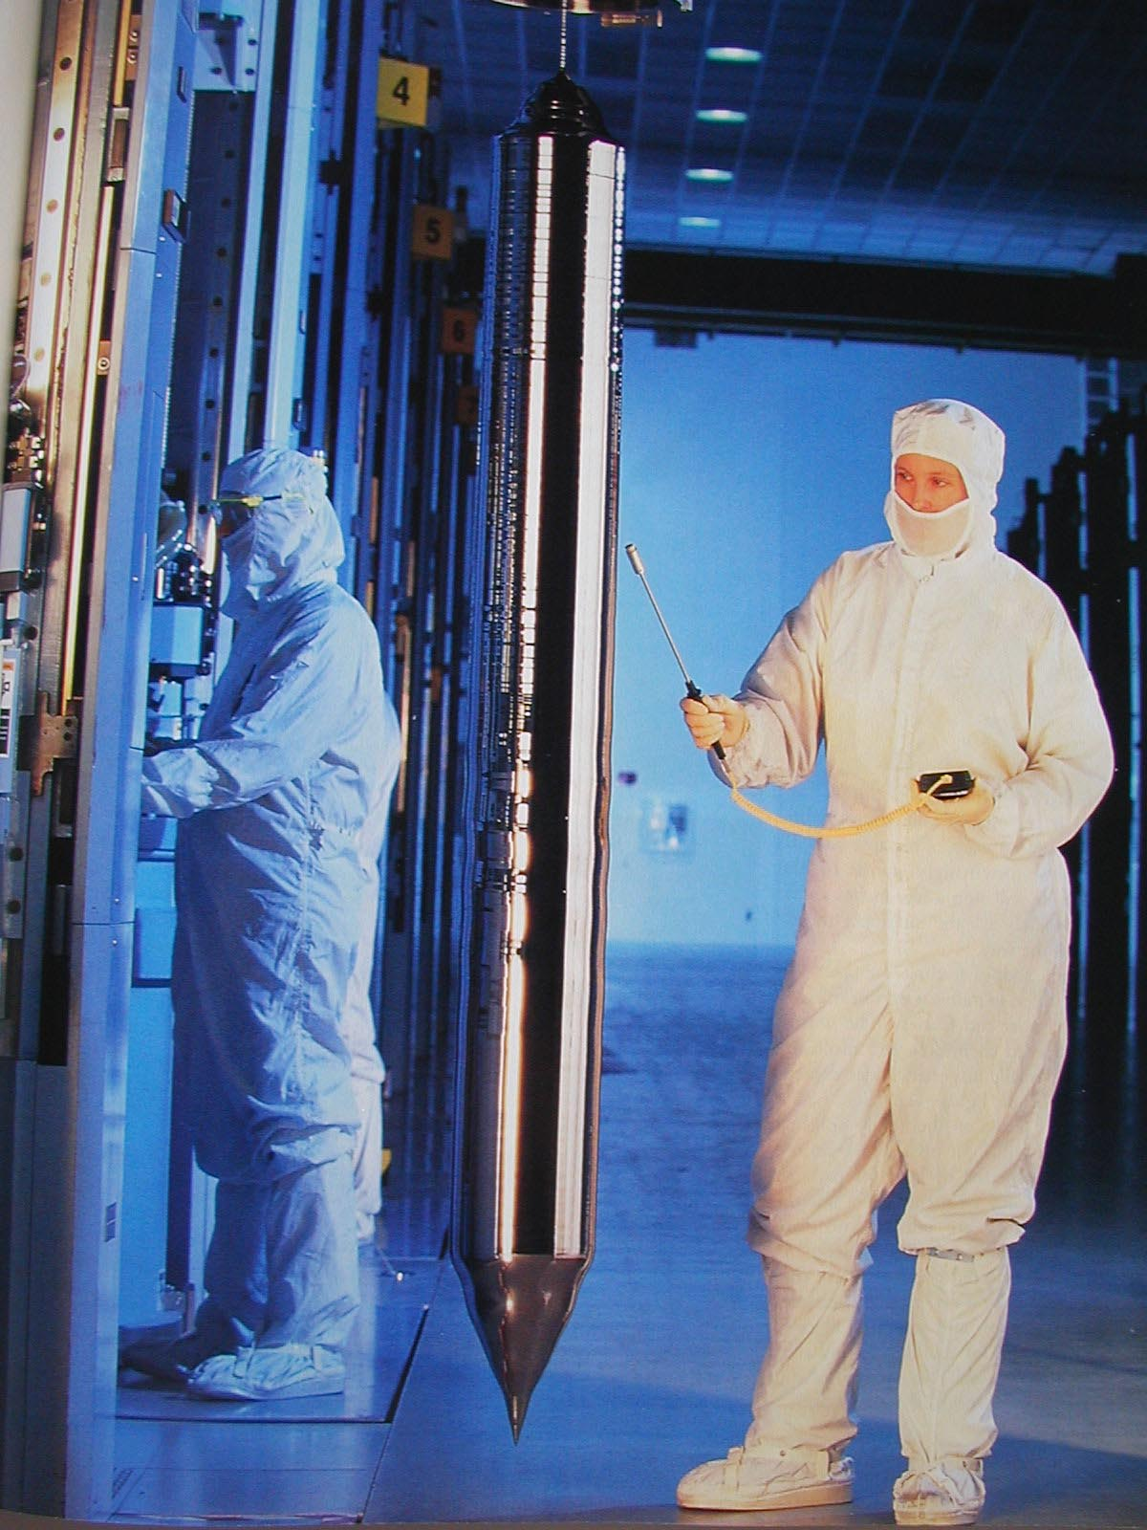
Growing the Silicon Ingot
From Smithsonian, 2000
Notes:
Base material is a single-crystalline, lightly doped wafer between 4 and 12 inches and a thickness of, at most, 1 mm – obtained from cutting a single-crystal ingot into thin slices. Starting wafer of p- type around 2 x 10**21 impurities/m**3.
The surface is then doped more heavily with a single crystal epitaxial layer grown over the surface before the wafer goes to the processing company.
Important metric – defect density

Slide 7
3. Lithography
Lithography: process used to transfer patterns to each layer of the IC.
Lithography sequence steps:
(i) Designing: Drawing the “layer” patterns on a layout editor
(ii) Silicon Foundry: Masks generation from the layer patterns in the design data base
(iii) Printing: transfer the mask pattern to the wafer surface. Process the wafer to physically pattern each layer of the IC.
(a) Photo resist application: The surface to be patterned is spin-coated with a light-sensitive organic polymer called photoresist
(b) Printing (exposure): The mask pattern is developed on the photoresist, with UV light exposure depending on the type of photoresist (negative or positive). The exposed or unexposed parts become resistant to certain types of solvents
(c) Development: The soluble photo resist is chemically removed.

Slide 8
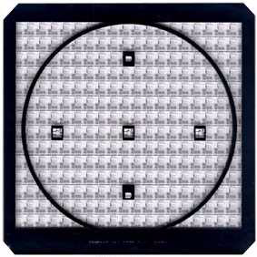
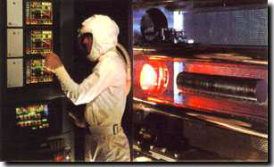
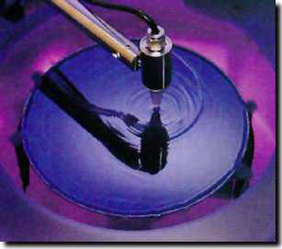
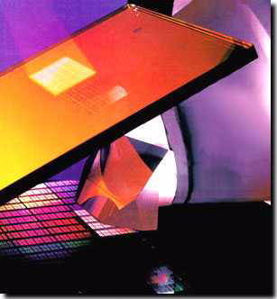
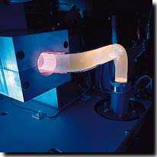
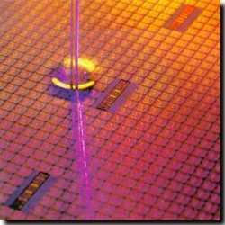
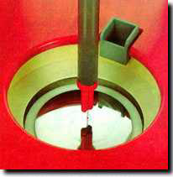
Photo-Lithographic Process
optical
oxidation
mask
photoresist
photoresist coating
removal (ashing)
stepper exposure
Typical operations in a single
photolithographic cycle (from [Fullman]).
photoresist
development
acid etch
process
spin, rinse, dry
step

Slide 9
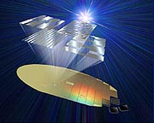
E-Beam Lithography
As the miniaturization of IC devices continues, electron beam exposure technology is gaining prominence as a technology for next-generation design rules
From: ADVANTEST CORPORATION

Slide 10
4. Oxide growth and removal
Oxide can be grown from silicon through heating in an oxidizing atmosphere. Additional silicon is absorbed through this process.
SiO2 is deposited on materials other than silicon through reaction between gaseous silicon compounds and oxidizers.
This works as insulation between different layers of metallization .
Once the desired shape is patterned with photoresist, the etching process allows unprotected materials to be removed
Wet etching: uses chemicals
Dry or plasma etching: uses ionized gases

Slide 11
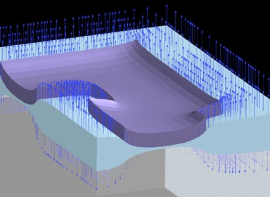
Silicon Oxidation
The oxide is grown by exposing the silicon surface to high temperature steam. As the oxide grows, the silicon is consumed. The arrows represent the direction of motion of each surface of the oxide.
Underneath the nitride mask, the growth is suppressed, and these areas will become the active transistor area.
Source: Bell Laboratories

Slide 12
Patterning - Photolithography
UV light
mask
Oxidation
Photoresist (PR) coating
Stepper exposure
Photoresist development and bake
Acid etching Unexposed (negative PR) Exposed (positive PR)
Spin, rinse, and dry
Processing step Ion implantation Plasma etching Metal deposition
Photoresist removal (ashing)
SiO₂
PR
Notes:
Same sequence patterns the complete surface of the wafer. Hence it is a very parallel process transferring hundreds of millions of patterns to the wafer surface simultaneously making cheap manufacturing of complex circuits possible.
1 – deposit thin layer of SiO2 by exposing it to a mixture of high-purity oxygen and hydrogen at 1000C
2 – light-sensitive polymer evenly applied while spinning the wafer to a thickness of 1 micron; polymers cross-link when exposed to light making the affected region insoluble (negative PR) or original insoluable, soluable after exposure (positive PR). COST OF MASKS IS INCREASING QUITE RAPIDLY WITH SCALING OF TECHNOLOGY – A REDUCTION OF MASKS IS OF HIGH PRIORITY!
3 – glass mask containing patter brought in close proximity to the wafer. Mask is transparent in regions we want to process and opaque elsewhere (positive PR). Combination exposed to UV light. Where mask is transparent, photoresist becomes soluable. Dimensions of features is approaching the wavelength of optical light sources (we’re good up to 0.1 micron). Will eventually move to X-ray or electron-beam (much less cost effective).
4 – Exposed photoresist is removed in a acid or base wash, then wafer is “soft-baked” to harden remaining PR
5 – Exposed material (SiO2) is removed via acid, base, and caustic solution wash.
6 – SRD – number of dust particles per cubic foot of air in clean room ranges between 1 and 10
8 – high-temperature plasma is used to selectively remove the remaining photoresist

Slide 13
CMOS Process at a Glance
One full photolithography sequence per layer (mask)
Built (roughly) from the bottom up
5 metal 2
4 metal 1
2 polysilicon
3 source and drain diffusions
1 tubs (aka wells, active areas)
Define active areas
Etch and fill trenches
Implant well regions
Deposit and pattern
polysilicon layer
exception!
Implant source and drain
regions and substrate contacts
Create contact and via windows
Deposit and pattern metal layers

Slide 14
Example of Patterning of SiO2
Chemical or plasma
etch
Hardened resist
Si-substrate
SiO
2
Si-substrate
Silicon base material
4. After development and etching of resist, chemical or plasma etch of SiO₂
Photoresist
SiO₂
Si-substrate
1&2. After oxidation and deposition of negative photoresist
Hardened resist
SiO₂
Si-substrate
UV-light
5. After etching
Patterned
optical mask
Exposed resist
SiO₂
Si-substrate
Si-substrate
3. Stepper exposure
8. Final result after removal of resist

Slide 15
5. Diffusion and ion implantation Doping materials are added to change the electrical characteristics of silicon locally through: Diffusion: Dopants deposited on silicon move through the lattice by thermal diffusion (high temperature process) wells Ion implantation: highly energized donor or acceptor atoms are implanted on the surface and travel below it. The patterned SiO2 serves as an implantation mask between Source and Drain regions

Slide 16
Diffusion and Ion Implantation
Area to be doped is exposed (photolithography)
Diffusion
or
Ion implantation
Notes:
Needed for well, source and drain regions, doping of polysilicon, adjustment of thresholds
Diffusion – wafer placed in quartz tube embedded in a furnace (900 to 1100 C). Gas containing dopant is introduced in the tub. Dopands diffused into the exposed surface both vertically and horizontally. Final dopant concentration is highest at surface and decreases in a gaussian profile deeper in the material
Ion implantation – Dopants are introduced as ions into the material by sweeping a beam of purified ions over the surface - acceleration determines how deep ions will penetrate and the beam current and exposure time determine dosage. Independent control of depth and dosage – ion implantation has largely displaced diffusion. However, has a side effect of causing lattice damage to substrate, so usually follow with an annealing step (wafer heated to 1000C for 15 to 30 minutes and allowed to cool slowly). Heating vibrates atoms and allows the bonds to reform.

Slide 17
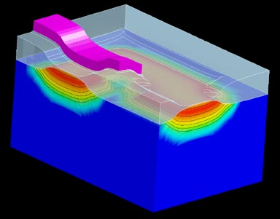
Ion Implantation
Dopant atoms are ionized and then accelerated by an electric field until they impinge on the silicon surface, where they embed themselves.
A polysilicon line crosses the active area in the upper left and forms the gate of a transistor.
Source: Bell Laboratories
Notes:
Needed for well, source and drain regions, doping of polysilicon, adjustment of thresholds
Diffusion – wafer placed in quartz tube embedded in a furnace (900 to 1100 C). Gas containing dopant is introduced in the tub. Dopands diffused into the exposed surface both vertically and horizontally. Final dopant concentration is highest at surface and decreases in a gaussian profile deeper in the material
Ion implantation – Dopants are introduced as ions into the material by sweeping a beam of purified ions over the surface - acceleration determines how deep ions will penetrate and the beam current and exposure time determine dosage. Independent control of depth and dosage – ion implantation has largely displaced diffusion. However, has a side effect of causing lattice damage to substrate, so usually follow with an annealing step (wafer heated to 1000C for 15 to 30 minutes and allowed to cool slowly). Heating vibrates atoms and allows the bonds to reform.

Slide 18
6. Annealing
Thermal annealing is a high temperature process which allows doping impurities to diffuse further into the bulk. This repairs lattice damage caused by the collisions with doping ions
7. Silicon deposition
Films of silicon can be added on the surface of a wafer
Epitaxy: Growth of a single-crystal semiconductor film on a crystalline substrate
Polysilicon: Polycrystalline film with a granular structure obtained through deposition of silicon on an amorphous material MOSFET gates.

Slide 19
Deposition and Etching
Pattern masking (photolithography)
Deposit material over entire wafer CVD (Si₃N₄) chemical deposition (polysilicon) sputtering (Al)
Etch away unwanted material wet etching dry (plasma) etching
Notes:
Needed for insulating SiO2, silicon nitride (sacrificial buffer), polysilicon, metal interconnect
CVD – chemical vapor deposition uses a gas-phase reaction with energy supplied by heat at around 850C. Use for, eg, silicon nitride
Chemical deposition – used for polysilicon. flow silane gas over the heated wafer (coated with SiO2) at approx. 650C. Resulting reaction produces a non-crystaline material – polysilicon. Followed by an implant step to increase its conductivity.
Sputtering – used for aluminum. Al evaporated in a vacuum, heat for evaporation delivered by e-bam bombarding.
Etching is then used to selectively form patterns (wires, contact holes). Wet etching using acid or basic solutions – hydrofluoric acid buffered with fluoride is used to etch SiO2. Plasma etching becoming more common. Use plasma molecules in heated chamber to “sandblast” the surface. Gives well-defined directionality to the etching action, creating patterns with sharp vertical contours.

Slide 20
8. Metallization
Deposition of metal layers by evaporation interconnections

Slide 21
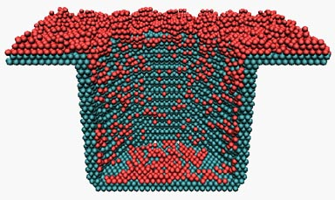
Metallization
First an insulating glass layer is deposited to cover the silicon, then contact holes are cut into the glass layer down to the silicon.
Metal is deposited on top of the glass, connecting to the devices through the contact holes.
The graphic shows a snapshot during the filling of a contact hole with aluminum.
Source: Bell Laboratories
Notes:
Needed for insulating SiO2, silicon nitride (sacrificial buffer), polysilicon, metal interconnect
CVD – chemical vapor deposition uses a gas-phase reaction with energy supplied by heat at around 850C. Use for, eg, silicon nitride
Chemical deposition – used for polysilicon. flow silane gas over the heated wafer (coated with SiO2) at approx. 650C. Resulting reaction produces a non-crystaline material – polysilicon. Followed by an implant step to increase its conductivity.
Sputtering – used for aluminum. Al evaporated in a vacuum, heat for evaporation delivered by e-bam bombarding.
Etching is then used to selectively form patterns (wires, contact holes). Wet etching using acid or basic solutions – hydrofluoric acid buffered with fluoride is used to etch SiO2. Plasma etching becoming more common. Use plasma molecules in heated chamber to “sandblast” the surface. Gives well-defined directionality to the etching action, creating patterns with sharp vertical contours.

Slide 22
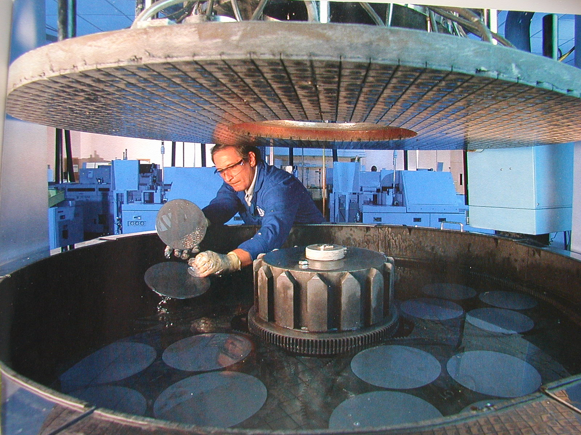
Planarization: Polishing the Wafers
From Smithsonian, 2000
Notes:
Essential to keep the surface of the wafer approximately flat between processing steps.
Chemical-mechanical planarization (CMP) step is included before the deposition of an extra metal layer on top of SiO2. The process uses a slurry compound – a liquid carrier with a suspended abrasive component such as aluminum oxide or silica – to microscopicall plane a device layer and to reduce step heights.

Slide 23
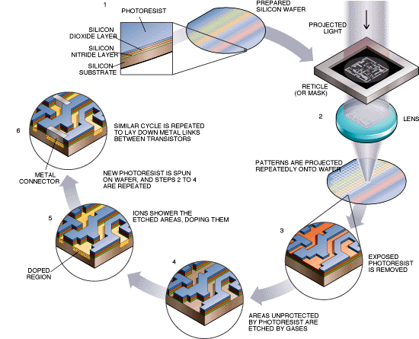
VLSI Fabrication: The Cycle

Slide 24
9. Testing
Test that chip for Design errors and Manufacturing errors
A single dust particle or wafer defect reduce yields from 90% to < 10%. This depends on die size, maturity of process. Test each part before shipping to customer.
10. Assembly and packaging
Tape out final layout. Fabricated 6", 8", 12” wafers are optimized for throughput.
In this process they are cut into individual dice. In packaging, wires are bounded from die I/O pads to package

